Slide 1


Microservices Design Principles
Building Scalable and Resilient Distributed Systems
Presented by Ghulam Shabbir

Slide 2

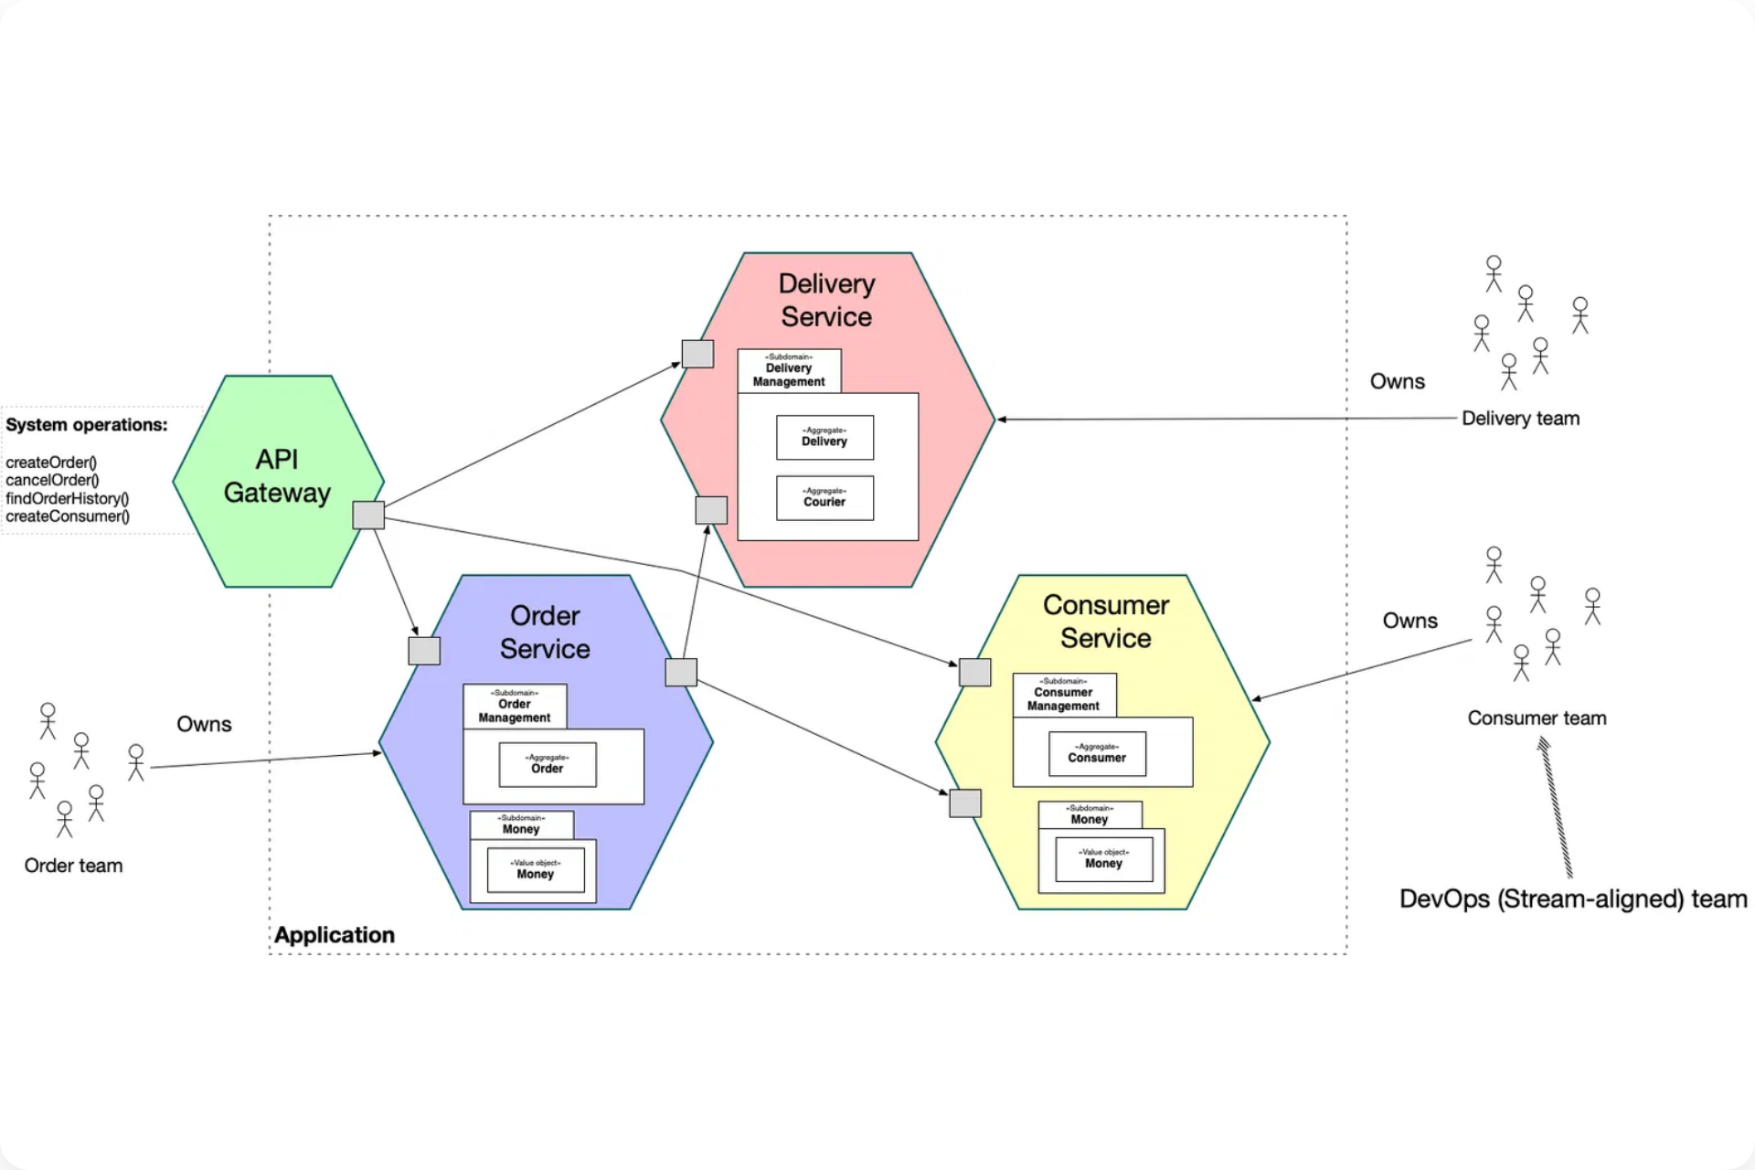
Introduction to Microservices
Microservices architecture
is an approach to developing
software applications as a suite of small, independently
deployable services that communicate over well-defined APIs.
Key Characteristics
Independently deployable services
Business capability focused
Decentralized governance
Failure isolation and resilience
Technology diversity
Microservices architecture showing service interactions
Primary Benefits
Enhanced scalability and performance
Faster development cycles
Improved fault tolerance
Technology flexibility

Slide 3
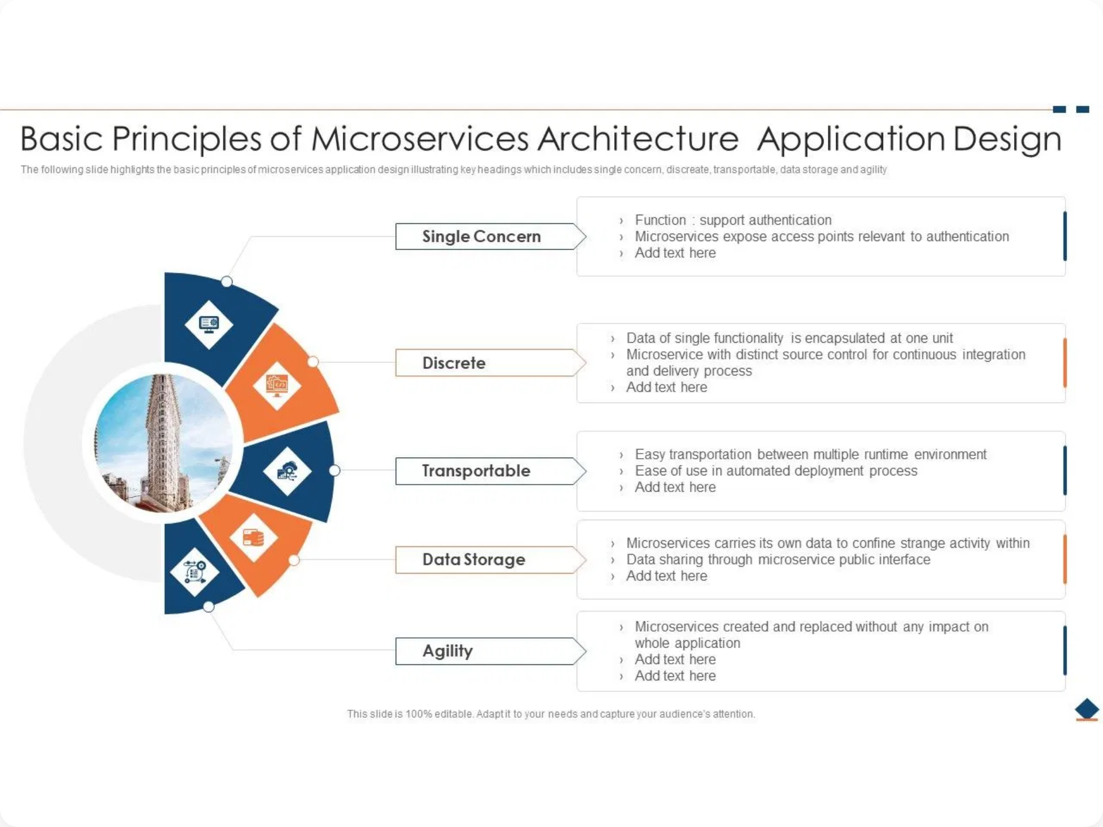



Core Design Principles - Part 1
Autonomy / Independent Services
Each microservice operates independently with its own lifecycle, deployment schedule, and technology stack. Services can be developed, tested, and deployed without coordination with other teams.
Single Responsibility Principle
Each service should focus on a single business capability or domain. This ensures services remain small, focused, and easier to understand and maintain.
Loose Coupling
Services should minimize dependencies on each other. Changes to one service should not require changes to other services, promoting flexibility and reducing system complexity.
Basic principles of microservices architecture application design

Slide 4

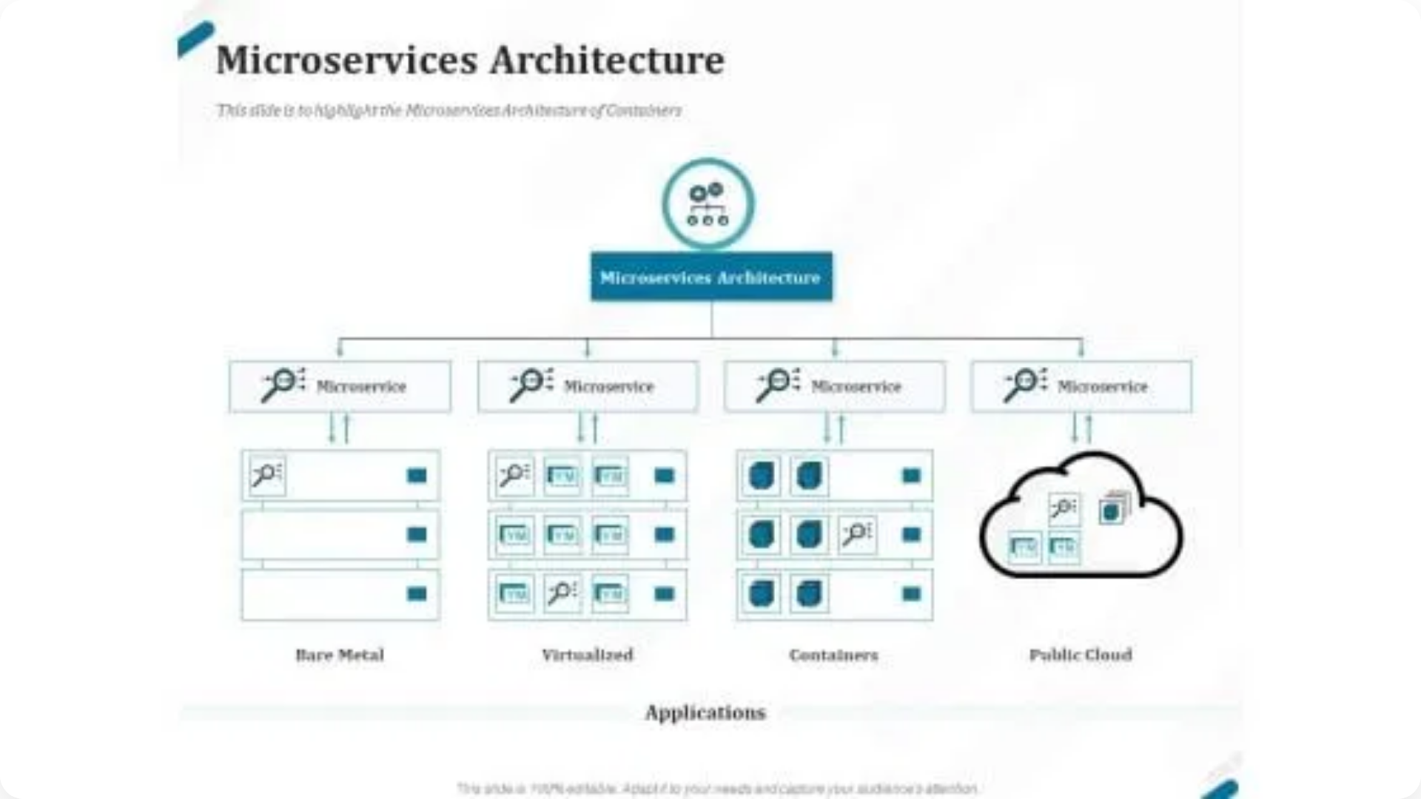


Core Design Principles - Part 2
Decentralized Data Management
Each service owns its data and database. This eliminates shared databases, reduces coupling, and allows services to choose the most appropriate data storage technology for their needs.
API-First Design
Services communicate through well-defined APIs, typically REST or messaging. APIs act as contracts between services, enabling independent development and technology choices.
Fault Tolerance / Resilience
Services must handle failures gracefully using patterns like circuit breakers, retries, and timeouts. System should continue operating even when individual services fail.
Icons representing different microservices principles and patterns

Slide 5
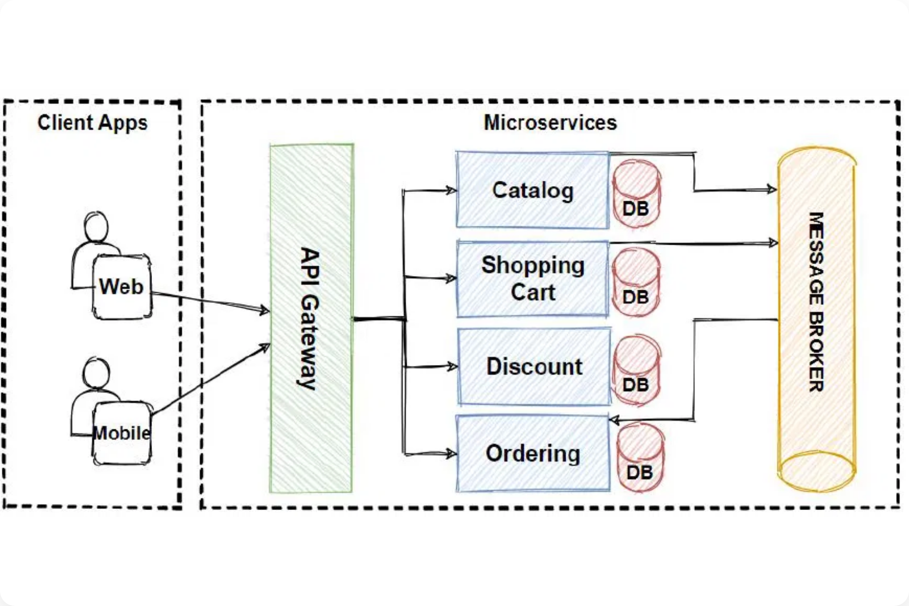



Microservices Communication
Synchronous vs Asynchronous
Synchronous communication (REST APIs) provides immediate responses but creates tight coupling. Asynchronous messaging (events, queues) enables loose coupling and better resilience.
API Gateway Pattern
A single entry point that routes requests to appropriate microservices. Handles cross-cutting concerns like authentication, rate limiting, and request/response transformation.
Diagram showing communication patterns between microservices
Service Discovery
Mechanism for services to find and communicate with each other dynamically. Essential for handling service instances that scale up/down or change locations.

Slide 6
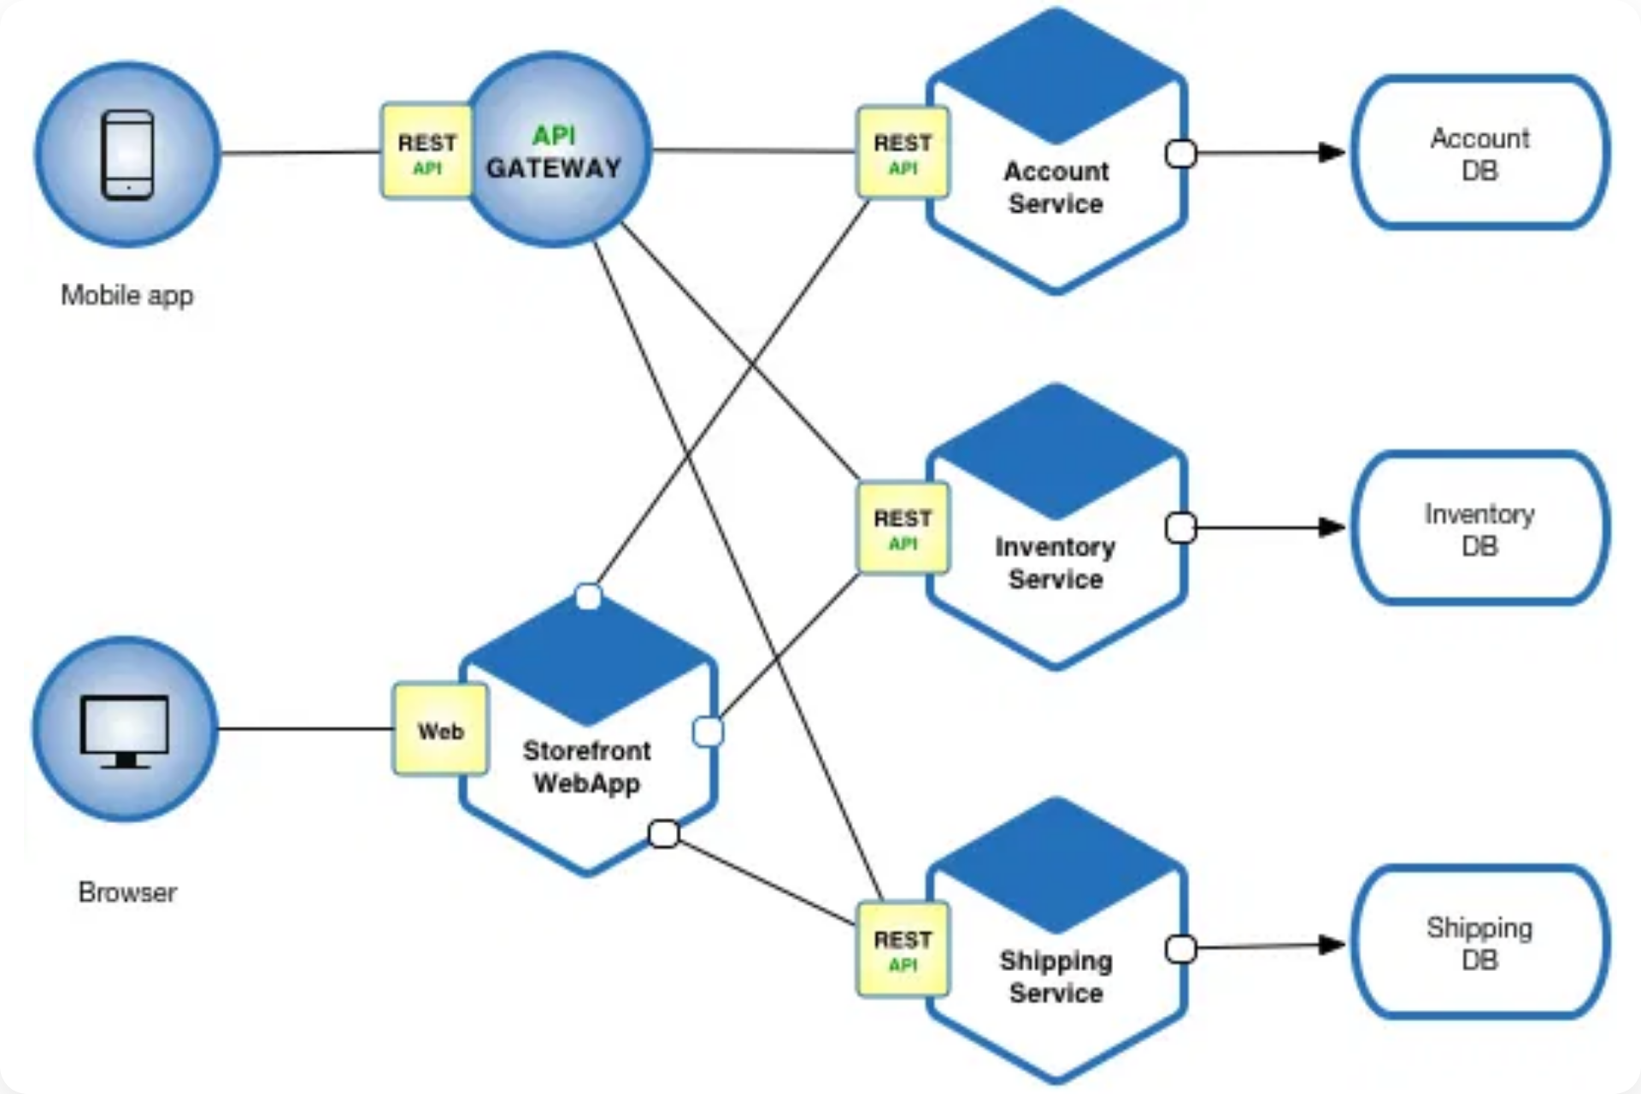



Deployment & Scalability
Independent Deployment
Each service can be deployed independently without affecting other services. This enables faster release cycles and reduces deployment risks through smaller, focused changes.
Containerization
Services are packaged in containers (Docker) ensuring consistent environments across development, testing, and production. Containers provide isolation and portability.
Microservices deployment architecture with multiple service instances
Horizontal Scaling
Services can be scaled independently by adding more instances based on demand. Load balancers distribute traffic across multiple service instances for optimal performance.

Slide 7
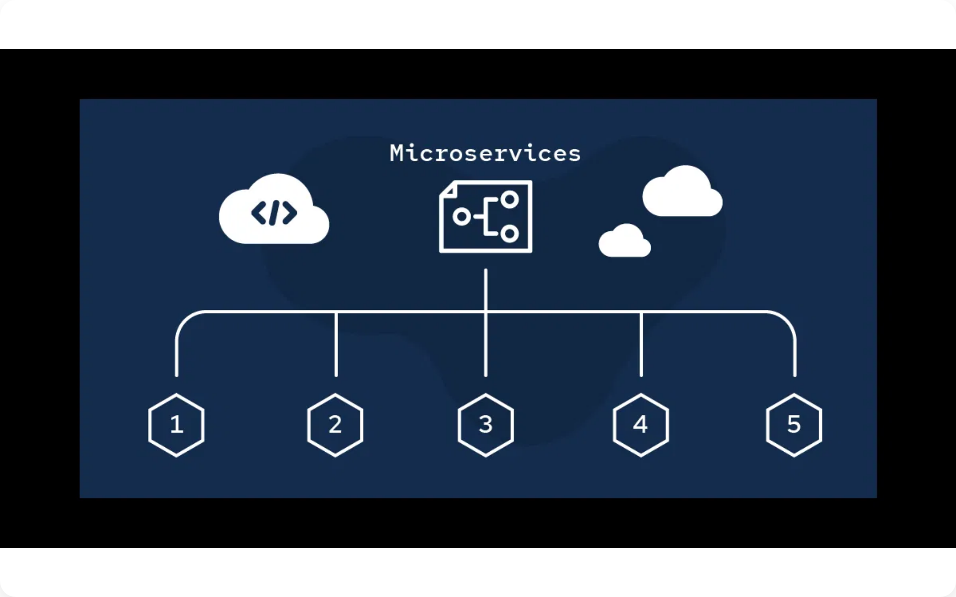



Monitoring & Management
Distributed Logging
Centralized log aggregation from all services using tools like ELK Stack or Fluentd. Correlation IDs help trace requests across multiple services for debugging.
Centralized Monitoring
Health checks, performance metrics, and alerting using tools like Prometheus, Grafana, or New Relic. Monitor service dependencies and system-wide performance.
Monitoring and management components in microservices architecture
Circuit Breakers
Prevent cascade failures by automatically stopping calls to failing services. Implements fail-fast behavior and graceful degradation when services are unavailable.

Slide 8
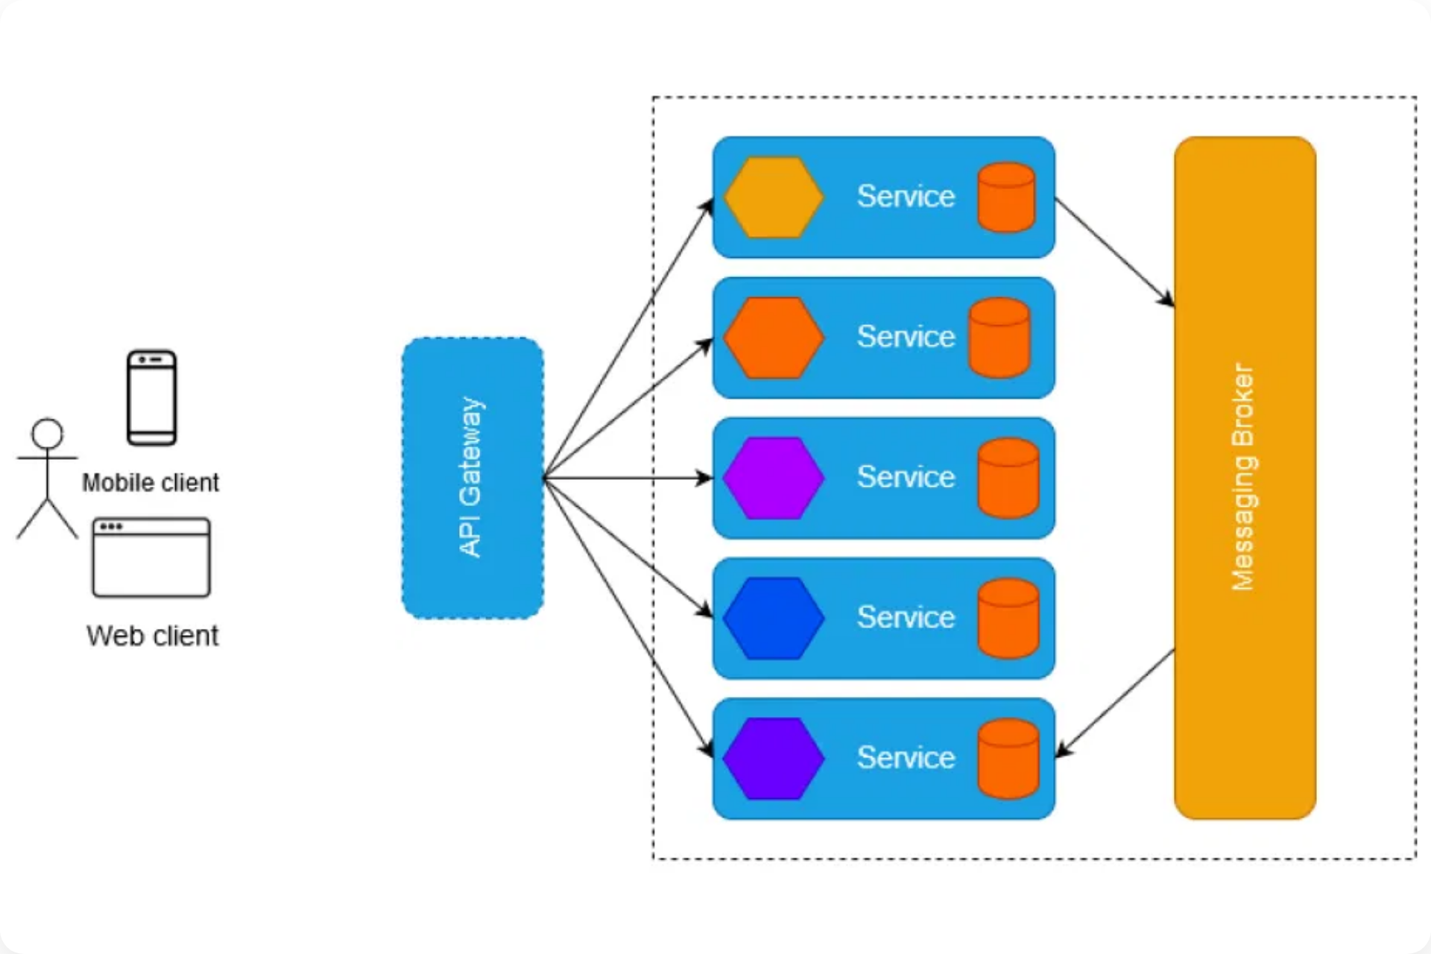



Best Practices & Challenges
When to Use Microservices
Suitable for complex applications with multiple teams, need for independent scaling, and organizational readiness for distributed systems complexity.
Common Pitfalls
Distributed system complexity, data consistency challenges, network latency issues, and over-decomposition leading to too many small services.
Microservices best practices and implementation considerations
Implementation Challenges
Requires robust DevOps practices, monitoring infrastructure, team coordination, and expertise in distributed systems patterns and technologies.

Slide 9


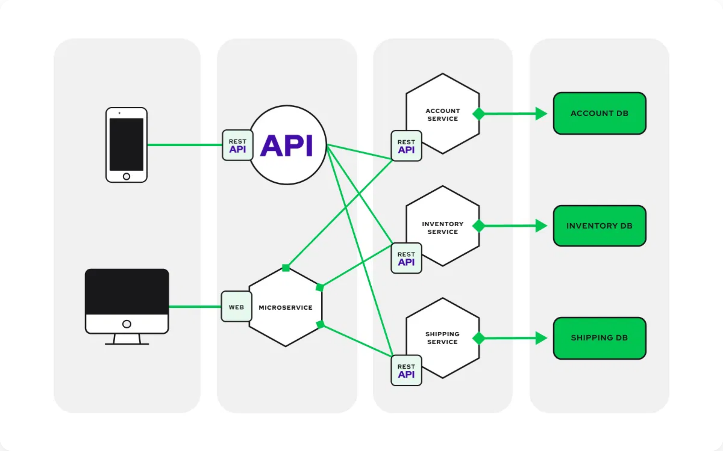


Summary & Conclusion
Key Principles Recap
Autonomy, Single Responsibility, Loose Coupling, Decentralized Data Management, API-First Design, and Fault Tolerance form the foundation of successful microservices architecture.
Future Trends
Serverless microservices, service mesh adoption, AI-driven monitoring, and cloud-native technologies will continue to shape microservices evolution.
Complete microservices ecosystem overview
Key Takeaways
Start small, invest in DevOps practices, prioritize monitoring, embrace automation, and ensure organizational readiness before adopting microservices.
Thank You!
Questions & Discussion

